Slide 1
Adventures in Test Driven Development and Pair Programming
Eric Helin
Software Engineer
Quicken Loans

Slide 2
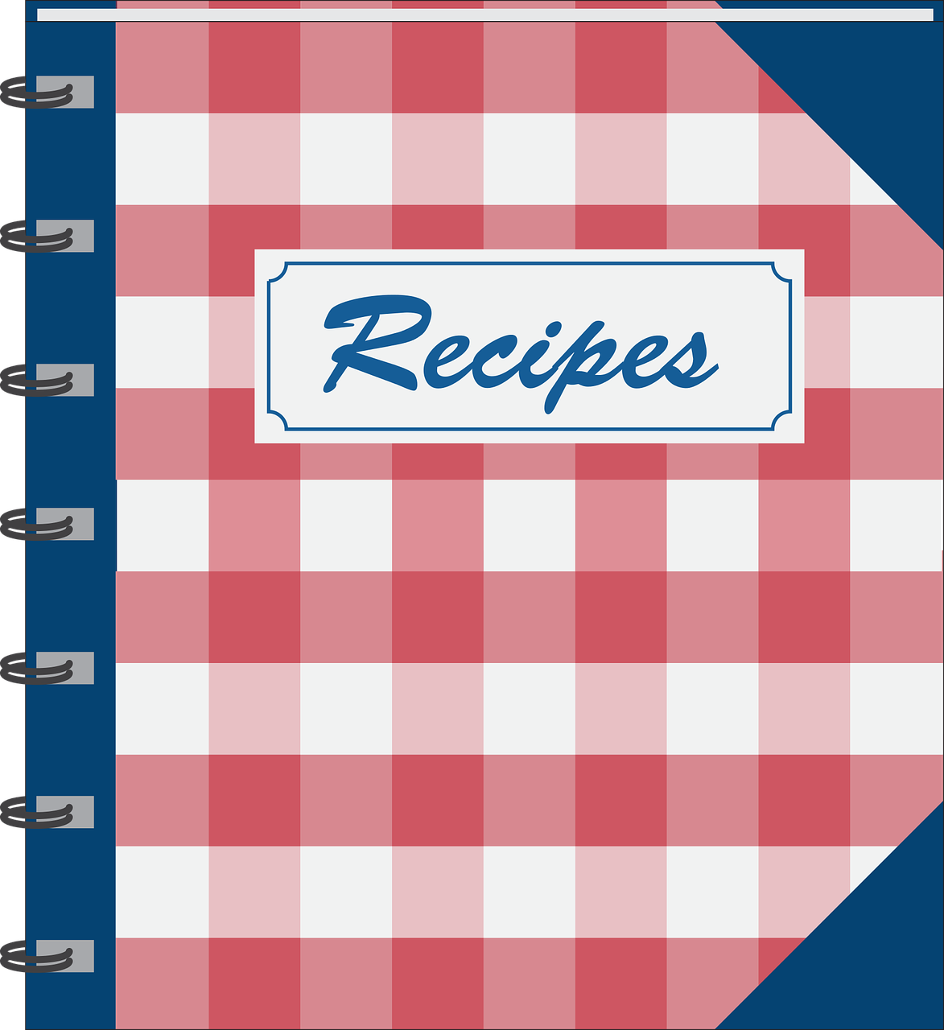
A Recipe for Better Software
Notes:
Free image - https://pixabay.com/en/book-cook-eat-food-kitchen-recipe-1292854/

Slide 3
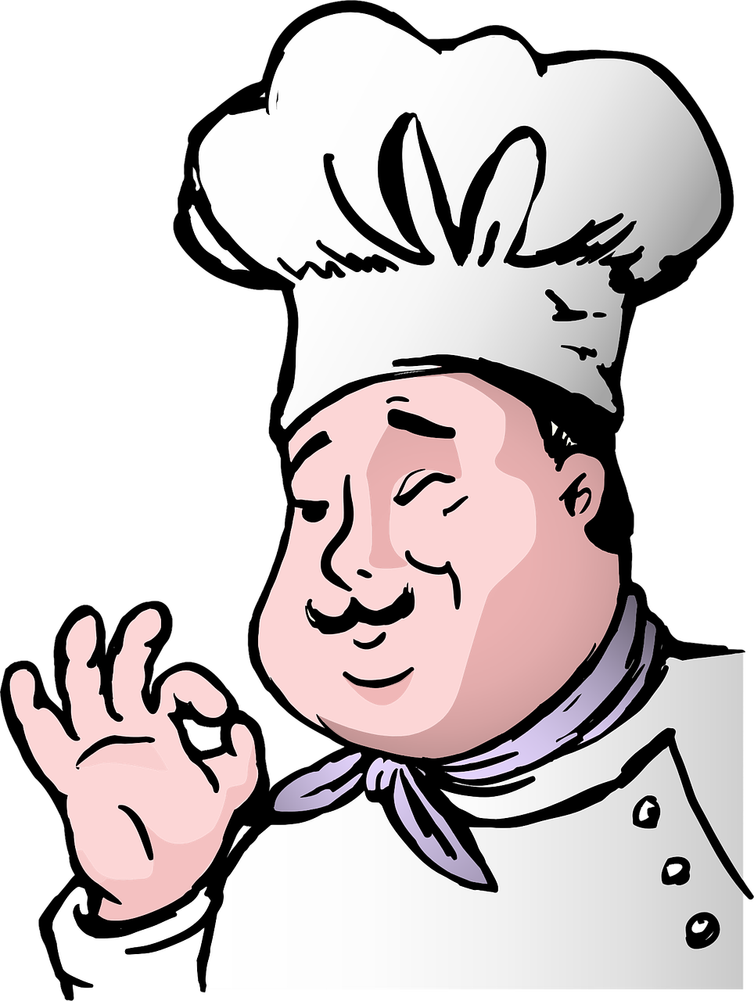
Great Tasting Software
Definitions of TDD and Pair Programming
Software Cooking – High-level process
Software Cooking – Process with more details
Let’s Cook! – Let’s review samples
How Does the recipe taste? – Sweet or Sour
Questions
Notes:
Free image - https://pixabay.com/en/cartoon-chef-chubby-comic-cook-1299636/

Slide 4
Test Driven Development is?
Notes:
Free image - https://pixabay.com/en/cartoon-chef-chubby-comic-cook-1299636/

Slide 5
Pair Programming is?
Notes:
Free image - https://pixabay.com/en/cartoon-chef-chubby-comic-cook-1299636/

Slide 6
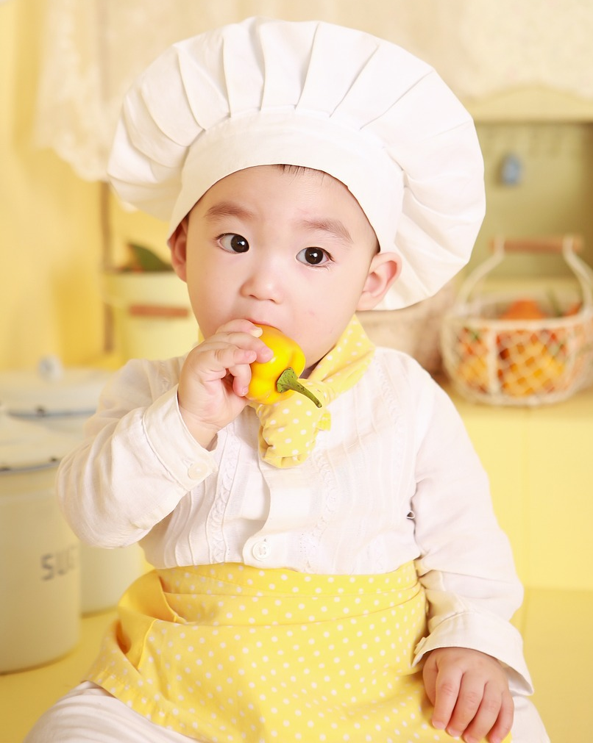
Software Cooking - High Level Process
Notes:
Free image - https://pixabay.com/en/cooking-baby-only-kitchen-chef-775503/

Slide 7

What are we trying to make?
Notes:
Free image - https://pixabay.com/en/question-mark-question-mark-423604/
Create our ‘work’ units (we used user stories)

Slide 8
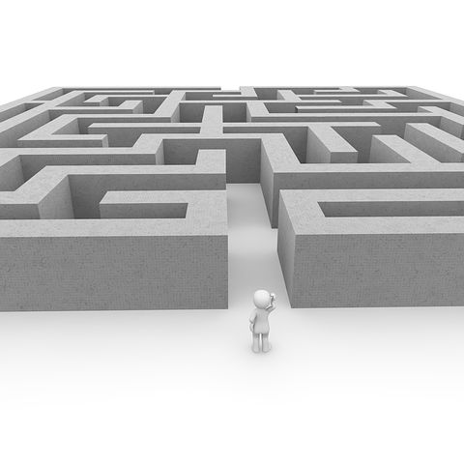
How complicated
is the recipe?
Notes:
Free Image - https://pixabay.com/en/labyrinth-run-complicated-lonely-1013625/
Developer's rank work (standard is to use some sort of pointing (i.e. fibonacci))

Slide 9

Can we agree on the ‘what’ & ‘how’?
Notes:
Free Image - https://pixabay.com/en/cooks-confectioner-children-s-842244/
Cooks meet and discuss in detail what is to be cooked (never have to many arguing cooks in the kitchen! ☺)
Pair Programming - Pair clarifies the work to be done (i.e. both on the same page)

Slide 10

Let’s Cook!!!
Notes:
Free Image - https://pixabay.com/en/cartoon-chef-comic-comic-characters-2025821/
Development pair starts and completes the unit of work

Slide 11

Informal Taste Test!
Notes:
Free image - https://pixabay.com/en/chefs-figures-funny-cook-1661131/
Acceptance of work

Slide 12

Format Taste Test!
Notes:
Free image - https://pixabay.com/en/adult-amorous-asia-girlfriend-1807617/
Deploy to production

Slide 13

Kitchen Huddle
Notes:
Free image - https://pixabay.com/en/quality-control-quality-1257235/
Retro

Slide 14

Software Cooking Process with more details
Notes:
Free image - https://pixabay.com/en/lens-camera-lens-focus-focusing-1209823/

Slide 15
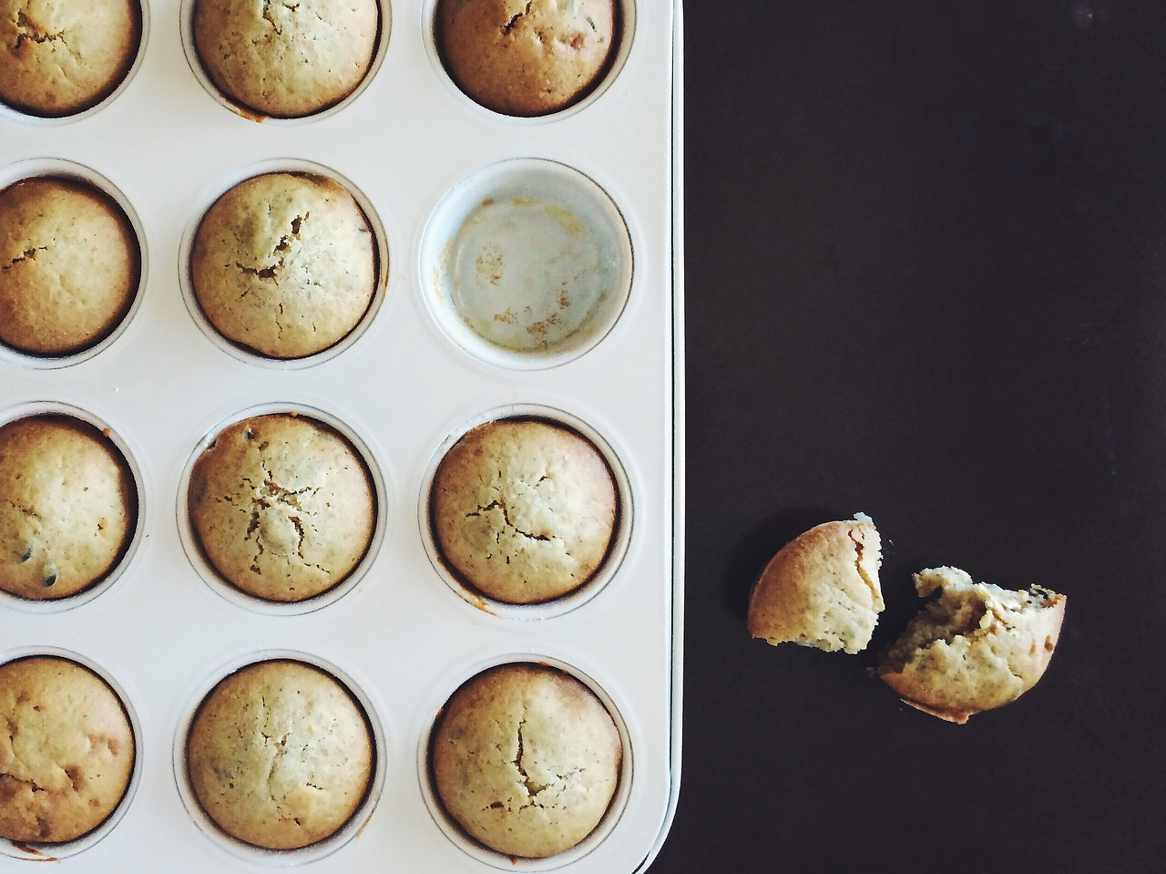
Small Batches
Notes:
Free image - https://pixabay.com/en/cupcake-pie-food-baking-sweets-1051159/
Cook in small batches and constantly taste
Iterations of creating small failing tests and fixing
Iterations of creating failing tests for a minimum amount of functionality followed by implemented code to enable that test to pass.
Example – route
Create integration test (will fail)
Create Unit test getting just status code (will fail)
Fix til 200 is received (i.e. only use reply({}, 200),
Update unit test with new functionality (i.e. request, validation, etc) until done
(start at highest/furthest level out)
Code interfaces/implementation is driven out by iterating through this process through routes, services and repositories until the story is completed.

Slide 16
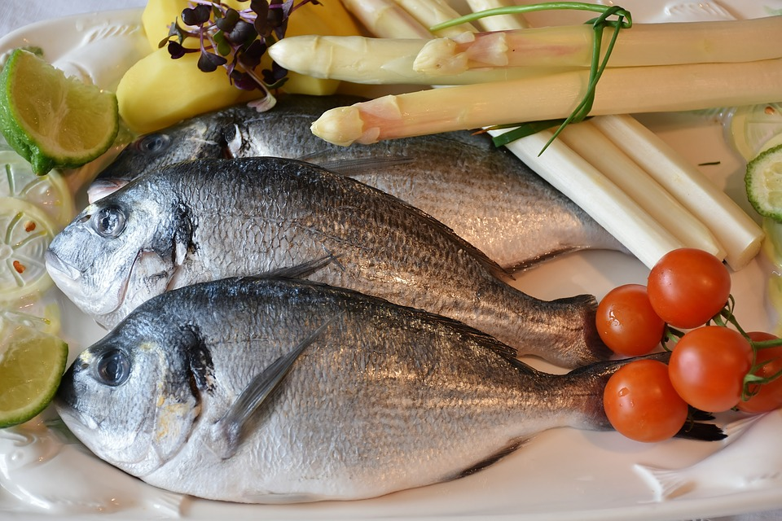
Main Course
Notes:
Image free - https://pixabay.com/en/fish-sea-bream-asparagus-2230852/
Create a failing integration test
This integration test will fail until the very end
Do we need an integration test? Depends…in my opinion
Integration tests are ‘flows’ through the system
Involve more than one endpoint (i.e. pulling credit has multiple endpoints)
Fewer Integration tests that unit tests
Testing Pyramid (https://martinfowler.com/bliki/TestPyramid.html)
UI/Acceptance tests (smallest)
Service/Integration tests (middle)
Unit tests (most)

Slide 17
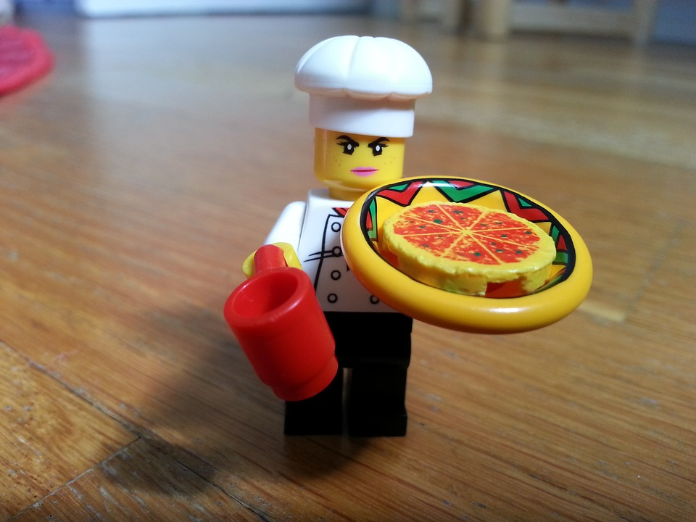
First dish in meal
Notes:
Free image – https://pixabay.com/en/lego-character-small-pizza-cook-393907/
Start first small portion of main course (Routes)
Start with next smallest technical unit and iterate over small failing tests with fixes until the current technical unit is complete.
Example
Create failing route unit test expecting status code of 200
Create route and only return 200 so it passes
Add request to test so it fails
Fix route to accept request so its passes
Add Validation to test (separate test) so it fails
Add Validation code so it passes
Mock service method call in test so it fails
Fix in Route so it passes

Slide 18
Next Dish
Notes:
Free image – https://pixabay.com/en/lego-character-small-pizza-cook-393907/
Start next small portion of main course (Services)
Start with next smallest technical unit and iterate over small failing tests with fixes until the current technical unit is complete.
Example
Create failing service unit test expecting an empty object
Create service and only return empty object so it passes
Add domain object to test so it fails
Fix service to accept domain object so its passes
Mock repository method call in test so it fails
Fix in service so it passes

Slide 19
Last Dish
In Meal
Notes:
Free image – https://pixabay.com/en/lego-character-small-pizza-cook-393907/
Start next small portion of main course (Repositories)
Start with next smallest technical unit and iterate over small failing tests with fixes until the current technical unit is complete.
Example
Create failing repository unit test expecting an empty object
Create repository and only return empty object so it passes
Add domain object to test so it fails
Fix repository to accept domain object so its passes
Mock data client and test that its method was call

Slide 20
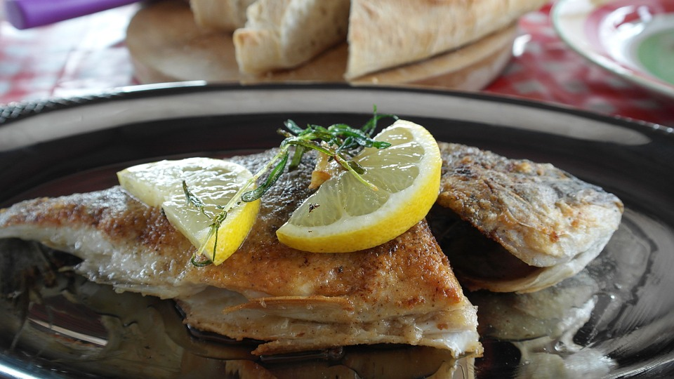
How does the main dish taste? Cooked ok?
Notes:
Free image – https://pixabay.com/en/fish-sea-bream-fried-lemon-food-716691/
Does the original Integration Test you created pass know? Still relevant?
Run previously failing integration test and fix any issues so it passes.
Ideally, if you did everything right, it should pass.

Slide 21
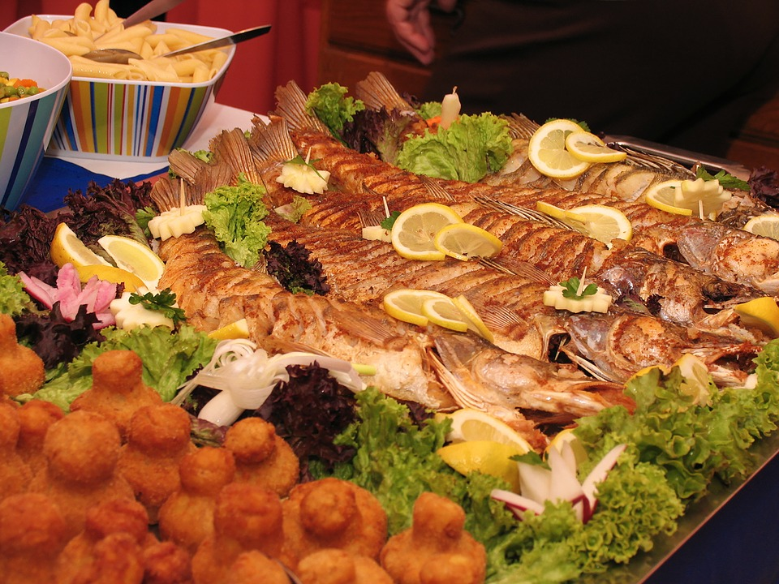
And the rest of the meal? Still taste ok?
Notes:
Free Image – https://pixabay.com/en/food-serving-shower-invitations-1082526/
Do all of the previous tests pass? Did we break anything?
Run all unit and integration tests and fix any that are broken

Slide 22
What does
the Head
Chef Say?
Notes:
Free image - https://pixabay.com/en/chefs-figures-funny-cook-1661131/
Serve to kitchen’s chief cook! How does it taste?
Check work into source control and deploy to test for acceptance
‘Accepting’ party passes or rejects work

Slide 23
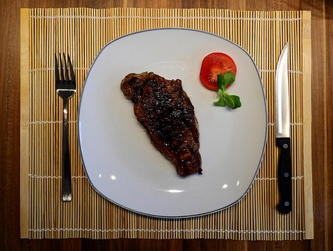
Serve to diners! Do they like it?
Notes:
Free image - https://pixabay.com/en/steak-meat-beef-eat-food-2272461/
Does it perform as expected in production?
Deployment of work

Slide 24
Kitchen Huddle
Notes:
Free image - https://pixabay.com/en/quality-control-quality-1257235/
Retro

Slide 25
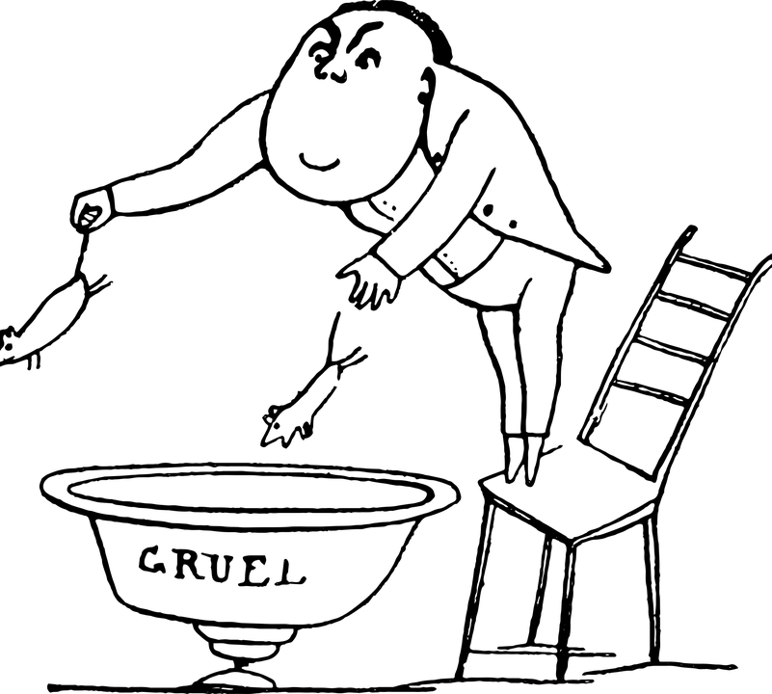
Let’s Cook! Making Some Samples
Will close presentation and flip to an IDE showing some samples
Notes:
Free image - https://pixabay.com/en/black-white-vintage-drawing-1817608/

Slide 26


How Does It Taste?
Notes:
Free frown image - https://pixabay.com/en/frowning-smiley-emoticon-smilies-150840/
Free Smile image - https://pixabay.com/en/smiley-yellow-happy-smile-emoticon-163510/

Slide 27
TDD
Notes:
Free frown image - https://pixabay.com/en/frowning-smiley-emoticon-smilies-150840/
Paradigm Shift
Takes lots of practice

Slide 28
Pair Programming
Notes:
Free frown image - https://pixabay.com/en/frowning-smiley-emoticon-smilies-150840/
Being constantly ‘on’ for 8 hours a day/5 days a week
Ways to compensate
Breaks
Strategic Soloing
Constantly being aware of state of other person (to fast? To slow? Engaged?)
Harder to go ‘deep’ on something
Paradigm shift (conversational learning/programming vs. tactile learning/programming)
Takes lots of practice and patience
Disagreements - Two Type A fist fights
Ways to compensate
sometimes just try it your pairs way
let each partner do a small poc and compare what is best
ask another pair's opinion to break a stalemate
Pair Programming – Disagreements - Two Type A fist fights
Ways to compensate
ultimately, the team decides

Slide 29
TDD
Notes:
Free Smile image - https://pixabay.com/en/smiley-yellow-happy-smile-emoticon-163510/
TDD produces strong test suites and installs greater confidence that team will know if something breaks

Slide 30
Pair Programming
Notes:
No Code review
Two pairs of eyes on every problem
Smaller chance of getting stumped for too long on a problem
Switching pairs every day
Fresh perspective
More exposure to all areas of the code

Slide 31

I will cook with TDD and Pair Programming!

Slide 32

Can you cook on your own?
Definitions of TDD and Pair Programming
Software Cooking – High-level process
Software Cooking – Process with more details
Let’s Cook! – Let’s review samples
How Does the recipe taste? – Sweet or Sour
Questions

Slide 33

Questions

Slide 34
Links
https://github.com/erichelin/detroitcodesamples

